Slide 1
Chapter 3
Describing Relationships
Section 3.1
Scatterplots and Correlation

Slide 2
Scatterplots and Correlation
Distinguish between explanatory and response variables for quantitative data.
Make a scatterplot to display the relationship between two quantitative variables.
Describe the direction, form, and strength of a relationship displayed in a scatterplot and identify unusual features.
Interpret the correlation.
Understand the basic properties of correlation, including how the correlation is influenced by outliers.
Distinguish correlation from causation.

Slide 3
Explanatory and Response Variables
Most statistical studies examine data on more than one variable. Analysis of relationships between two variables builds on the same tools we used to analyze one variable.

Slide 4
Explanatory and Response Variables
Most statistical studies examine data on more than one variable. Analysis of relationships between two variables builds on the same tools we used to analyze one variable.
A response variable measures an outcome of a study.
An explanatory variable may help predict or explain changes in a response variable.

Slide 5
Explanatory and Response Variables
Most statistical studies examine data on more than one variable. Analysis of relationships between two variables builds on the same tools we used to analyze one variable.
A response variable measures an outcome of a study.
An explanatory variable may help predict or explain changes in a response variable.
Note: In many studies, the goal is to show that changes in one or more explanatory variables actually cause changes in a response variable. However, other explanatory-response relationships don’t involve direct causation.

Slide 6
Displaying Relationships: Scatterplots
A scatterplot shows the relationship (association) between two quantitative variables measured on the same individuals. The values of one variable appear on the horizontal axis, and the values of the other variable appear on the vertical axis. Each individual in the data set appears as a point in the graph.

Slide 7
Displaying Relationships: Scatterplots
A scatterplot shows the relationship (association) between two quantitative variables measured on the same individuals. The values of one variable appear on the horizontal axis, and the values of the other variable appear on the vertical axis. Each individual in the data set appears as a point in the graph.
How to Make a Scatterplot
Label the axes. The eXplanatory variable goes on the horizontal (X-axis). The response variable goes on the vertical axis. If there is no explanatory variable, either variable can go on the horizontal axis.
Scale the axes.
Plot individual data values.

Slide 8
Describing Scatterplots
To describe a scatterplot, follow the basic strategy of data analysis from Chapter 1: look for patterns and important departures from those patterns.

Slide 9
Describing Scatterplots
To describe a scatterplot, follow the basic strategy of data analysis from Chapter 1: look for patterns and important departures from those patterns.
Two variables have a positive association when above-average values of one variable tend to accompany above-average values of the other variable and when below-average values also tend to occur together.

Slide 10
Describing Scatterplots
To describe a scatterplot, follow the basic strategy of data analysis from Chapter 1: look for patterns and important departures from those patterns.
Two variables have a positive association when above-average values of one variable tend to accompany above-average values of the other variable and when below-average values also tend to occur together.
Two variables have a negative association when above-average values of one variable tend to accompany below-average values of the other variable.

Slide 11
Describing Scatterplots
To describe a scatterplot, follow the basic strategy of data analysis from Chapter 1: look for patterns and important departures from those patterns.
Two variables have a positive association when above-average values of one variable tend to accompany above-average values of the other variable and when below-average values also tend to occur together.
Two variables have a negative association when above-average values of one variable tend to accompany below-average values of the other variable.
There is no association between two variables if knowing the value of one variable does not help us predict the value of the other variable.

Slide 12
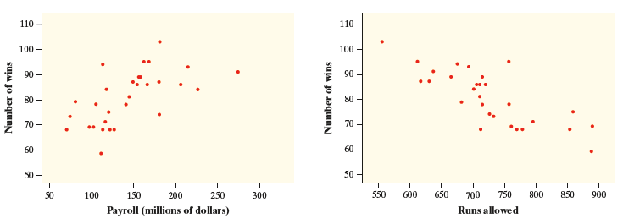
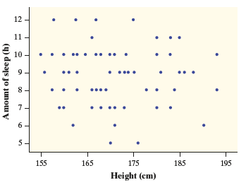
Describing Scatterplots

Slide 13
Describing Scatterplots
Positive Association

Slide 14
Describing Scatterplots
Positive Association
Negative Association

Slide 15
Describing Scatterplots
Positive Association
Negative Association
No Association

Slide 16
Describing Scatterplots
How to Describe a Scatterplot
To describe a scatterplot, make sure to address the following four characteristics in the context of the data:

Slide 17
Describing Scatterplots
How to Describe a Scatterplot
To describe a scatterplot, make sure to address the following four characteristics in the context of the data:
Direction: A scatterplot can show a positive association, negative association, or no association.

Slide 18
Describing Scatterplots
How to Describe a Scatterplot
To describe a scatterplot, make sure to address the following four characteristics in the context of the data:
Direction: A scatterplot can show a positive association, negative association, or no association.
Form: A scatterplot can show a linear form or a nonlinear form. The form is linear if the overall pattern follows a straight line. Otherwise, the form is nonlinear.

Slide 19
Describing Scatterplots
How to Describe a Scatterplot
To describe a scatterplot, make sure to address the following four characteristics in the context of the data:
Direction: A scatterplot can show a positive association, negative association, or no association.
Form: A scatterplot can show a linear form or a nonlinear form. The form is linear if the overall pattern follows a straight line. Otherwise, the form is nonlinear.
Strength: A scatterplot can show a weak, moderate, or strong association. An association is strong if the points don’t deviate much from the form identified. An association is weak if the points deviate quite a bit from the form identified.

Slide 20
Describing Scatterplots
How to Describe a Scatterplot
To describe a scatterplot, make sure to address the following four characteristics in the context of the data:
Direction: A scatterplot can show a positive association, negative association, or no association.
Form: A scatterplot can show a linear form or a nonlinear form. The form is linear if the overall pattern follows a straight line. Otherwise, the form is nonlinear.
Strength: A scatterplot can show a weak, moderate, or strong association. An association is strong if the points don’t deviate much from the form identified. An association is weak if the points deviate quite a bit from the form identified.
Unusual features: Look for outliers that fall outside the overall pattern and distinct clusters of points.

Slide 21
Describing Scatterplots
How to Describe a Scatterplot
To describe a scatterplot, make sure to address the following four characteristics in the context of the data:
Direction: A scatterplot can show a positive association, negative association, or no association.
Form: A scatterplot can show a linear form or a nonlinear form. The form is linear if the overall pattern follows a straight line. Otherwise, the form is nonlinear.
Strength: A scatterplot can show a weak, moderate, or strong association. An association is strong if the points don’t deviate much from the form identified. An association is weak if the points deviate quite a bit from the form identified.
Unusual features: Look for outliers that fall outside the overall pattern and distinct clusters of points.
CAUTION:
When describing the association shown in a scatterplot, write in the context of the problem.
This means that you need to use both variable names in your description.

Slide 22
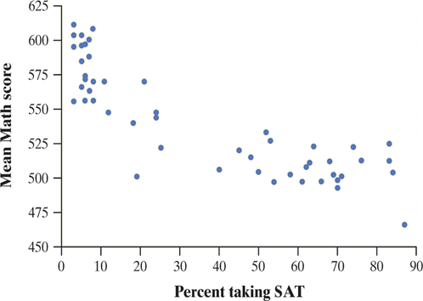
Describing Scatterplots
The scatterplot shows the association between mean SAT Math score and percent of students who take the SAT for the 50 U.S. states. Describe the association shown by the scatterplot.

Slide 23
Describing Scatterplots
The scatterplot shows the association between mean SAT Math score and percent of students who take the SAT for the 50 U.S. states. Describe the association shown by the scatterplot.
There is a moderately strong, negative, curved relationship between the percent of students in a state who take the SAT and the mean SAT math score.
Further, there are two distinct clusters of states and two possible outliers that fall outside the overall pattern.

Slide 24
Describing Scatterplots
The scatterplot shows the association between mean SAT Math score and percent of students who take the SAT for the 50 U.S. states. Describe the association shown by the scatterplot.
Strength
There is a moderately strong, negative, curved relationship between the percent of students in a state who take the SAT and the mean SAT math score.
Further, there are two distinct clusters of states and two possible outliers that fall outside the overall pattern.

Slide 25
Describing Scatterplots
The scatterplot shows the association between mean SAT Math score and percent of students who take the SAT for the 50 U.S. states. Describe the association shown by the scatterplot.
Strength
Direction
There is a moderately strong, negative, curved relationship between the percent of students in a state who take the SAT and the mean SAT math score.
Further, there are two distinct clusters of states and two possible outliers that fall outside the overall pattern.

Slide 26
Describing Scatterplots
The scatterplot shows the association between mean SAT Math score and percent of students who take the SAT for the 50 U.S. states. Describe the association shown by the scatterplot.
Strength
Direction
There is a moderately strong, negative, curved relationship between the percent of students in a state who take the SAT and the mean SAT math score.
Further, there are two distinct clusters of states and two possible outliers that fall outside the overall pattern.
Form

Slide 27
Describing Scatterplots
The scatterplot shows the association between mean SAT Math score and percent of students who take the SAT for the 50 U.S. states. Describe the association shown by the scatterplot.
Strength
Direction
There is a moderately strong, negative, curved relationship between the percent of students in a state who take the SAT and the mean SAT math score.
Further, there are two distinct clusters of states and two possible outliers that fall outside the overall pattern.
Form
Unusual features

Slide 28
Measuring Linear Association: Correlation
A scatterplot displays the direction, form, and strength of a relationship between two quantitative variables. When the association between two quantitative variables is linear, we can use the correlation r to help describe the strength and direction of the association.

Slide 29
Measuring Linear Association: Correlation
A scatterplot displays the direction, form, and strength of a relationship between two quantitative variables. When the association between two quantitative variables is linear, we can use the correlation r to help describe the strength and direction of the association.
For a linear association between two quantitative variables, the correlation r measures the direction and strength of the association.

Slide 30
Measuring Linear Association: Correlation
A scatterplot displays the direction, form, and strength of a relationship between two quantitative variables. When the association between two quantitative variables is linear, we can use the correlation r to help describe the strength and direction of the association.
For a linear association between two quantitative variables, the correlation r measures the direction and strength of the association.
CAUTION:
It is only appropriate to use the correlation to describe strength and direction for a linear relationship.

Slide 31
Measuring Linear Association: Correlation
Some Important Properties of the Correlation r
The correlation r is always a number between –1 and 1 (–1 ≤ r ≤ 1).

Slide 32
Measuring Linear Association: Correlation
Some Important Properties of the Correlation r
The correlation r is always a number between –1 and 1 (–1 ≤ r ≤ 1).
The correlation r indicates the direction of a linear relationship by its sign: r > 0 for a positive association and r < 0 for a negative association.

Slide 33
Measuring Linear Association: Correlation
Some Important Properties of the Correlation r
The correlation r is always a number between –1 and 1 (–1 ≤ r ≤ 1).
The correlation r indicates the direction of a linear relationship by its sign: r > 0 for a positive association and r < 0 for a negative association.
The extreme values r = –1 and r = 1 occur only in the case of a perfect linear relationship, when the points lie exactly along a straight line.

Slide 34
Measuring Linear Association: Correlation
Some Important Properties of the Correlation r
The correlation r is always a number between –1 and 1 (–1 ≤ r ≤ 1).
The correlation r indicates the direction of a linear relationship by its sign: r > 0 for a positive association and r < 0 for a negative association.
The extreme values r = –1 and r = 1 occur only in the case of a perfect linear relationship, when the points lie exactly along a straight line.
If the linear relationship is strong, the correlation r will be close to 1 or –1.

Slide 35
Measuring Linear Association: Correlation
Some Important Properties of the Correlation r
The correlation r is always a number between –1 and 1 (–1 ≤ r ≤ 1).
The correlation r indicates the direction of a linear relationship by its sign: r > 0 for a positive association and r < 0 for a negative association.
The extreme values r = –1 and r = 1 occur only in the case of a perfect linear relationship, when the points lie exactly along a straight line.
If the linear relationship is strong, the correlation r will be close to 1 or –1.
If the linear relationship is weak, the correlation r will be close to 0.

Slide 36
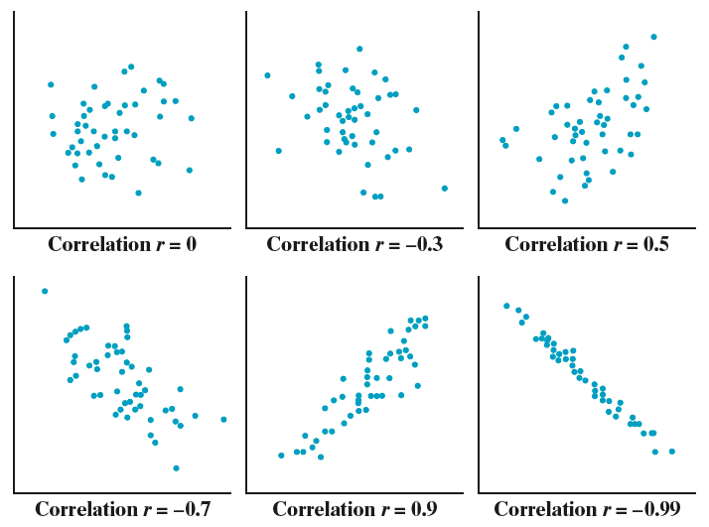
Measuring Linear Association: Correlation

Slide 37
Cautions about Correlation
CAUTION:
Correlation doesn’t imply causation.

Slide 38
Cautions about Correlation
CAUTION:
Correlation doesn’t imply causation.
Correlation does not measure form.

Slide 39
Cautions about Correlation
CAUTION:
Correlation doesn’t imply causation.
Correlation does not measure form.
Correlation should only be used to describe linear relationships.

Slide 40
Cautions about Correlation
CAUTION:
Correlation doesn’t imply causation.
Correlation does not measure form.
Correlation should only be used to describe linear relationships.
Correlation is not a resistant measure of strength.

Slide 41
Calculating Correlation
How to Calculate the Correlation r
Suppose that we have data on variables x and y for n individuals. The values for the first individual are x₁ and y₁, the values for the second individual are x₂ and y₂, and so on. The means and standard deviations of the two variables are $\overline{x}$ and s_{x} for the x-values and $\overline{y}$ and s_{y} for the y-values.
The correlation r between x and y is:

Slide 42
Calculating Correlation
How to Calculate the Correlation r
Suppose that we have data on variables x and y for n individuals. The values for the first individual are x₁ and y₁, the values for the second individual are x₂ and y₂, and so on. The means and standard deviations of the two variables are $\overline{x}$ and s_{x} for the x-values and $\overline{y}$ and s_{y} for the y-values.
The correlation r between x and y is:

Slide 43
Facts About Correlation
How correlation behaves is more important than the details of the formula. Here are some important facts about r.

Slide 44
Facts About Correlation
How correlation behaves is more important than the details of the formula. Here are some important facts about r.
Correlation requires that both variables be quantitative.

Slide 45
Facts About Correlation
How correlation behaves is more important than the details of the formula. Here are some important facts about r.
Correlation requires that both variables be quantitative.
Correlation makes no distinction between explanatory and response variables.

Slide 46
Facts About Correlation
How correlation behaves is more important than the details of the formula. Here are some important facts about r.
Correlation requires that both variables be quantitative.
Correlation makes no distinction between explanatory and response variables.
r does not change when we change the units of measurement of x, y, or both.

Slide 47
Facts About Correlation
How correlation behaves is more important than the details of the formula. Here are some important facts about r.
Correlation requires that both variables be quantitative.
Correlation makes no distinction between explanatory and response variables.
r does not change when we change the units of measurement of x, y, or both.
The correlation r has no unit of measurement. It’s just a number.

Slide 48
Section Summary
Distinguish between explanatory and response variables for quantitative data.
Make a scatterplot to display the relationship between two quantitative variables.
Describe the direction, form, and strength of a relationship displayed in a scatterplot and identify unusual features.
Interpret the correlation.
Understand the basic properties of correlation, including how the correlation is influenced by outliers.
Distinguish correlation from causation.

Slide 49
Assignment
3.1 p. 171-175 #2-26 EOE (Every Other Even) and 29-35 all
Switch 14 for 16
(2, 6, 10, 16, 18, 22, 26, 29-35)
Extra help with 22 on next slides.
If you are stuck on any of these, look at the odd before or after and the answer in the back of your book. If you are still not sure text a friend or me for help (before 8pm).
Tomorrow we will check homework and review for 3.1 Quiz.

Slide 50
Calculating Correlation
How to Calculate the Correlation r
Suppose that we have data on variables x and y for n individuals. The values for the first individual are x₁ and y₁, the values for the second individual are x₂ and y₂, and so on. The means and standard deviations of the two variables are $\overline{x}$ and s_{x} for the x-values and $\overline{y}$ and s_{y} for the y-values.
The correlation r between x and y is:

Slide 51
Calculating Correlation
22b. Start by putting the women in list 1 and men in list 2,
(which should already be done to help you with your graph.)
Then run 1-Var Stats for each list to get the Mean and SD.
Women mean 66, SD 2.0976
Men mean 69, SD 2.5298
Now use the formula to calculate each value.
1st woman= 1st man=
The multiply the 2 numbers together and record the total.
Continue this pattern and add all the products.

Slide 52
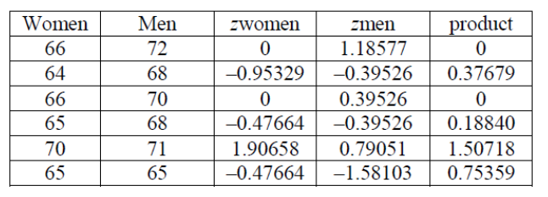
Calculating Correlation
It would be best to record you data in a table like the one below.
zwomen and zmen is the number from following the first part of the formula.
Make sure you finish the formula.

