Slide 1
Pull 2 samples of 3 pennies and record both averages (2 dots).
We are going to discuss 5.1 today.

Slide 2


Chapter 5
Probability: What Are the Chances?
Section 5.1
Randomness, Probability,
and Simulation

Slide 3
Probability, Randomness, and Simulation
INTERPRET probability as a long-run relative frequency.
USE simulation to model chance behavior.

Slide 4
The Idea of Probability
Chance behavior is unpredictable
in the short run but has a regular and predictable pattern in the long run.

Slide 5
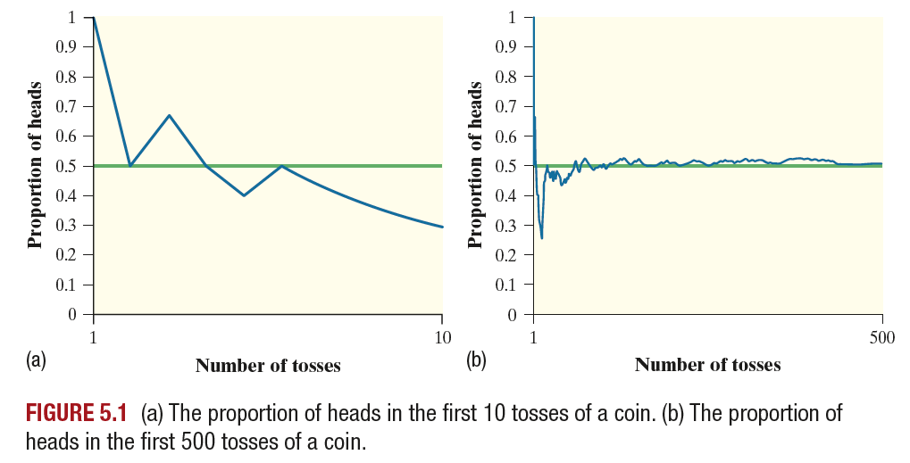
The Idea of Probability
Chance behavior is unpredictable
in the short run but has a regular and predictable pattern in the long run.

Slide 6
The Idea of Probability
Chance behavior is unpredictable
in the short run but has a regular and predictable pattern in the long run.

Slide 7
The Idea of Probability
Chance behavior is unpredictable
in the short run but has a regular and predictable pattern in the long run.

Slide 8
The Idea of Probability
The probability of any outcome of a chance process is a number between 0 and 1 that describes the proportion of times the outcome would occur in a very long series of repetitions.

Slide 9
The Idea of Probability
The law of large numbers says that if we observe more and more repetitions of any chance process, the proportion of times that a specific outcome occurs approaches its probability.

Slide 10
Understanding Randomness
The idea of probability is that randomness is predictable in the long run.
Eyebyte/Alamy

Slide 11
Understanding Randomness
The idea of probability is that randomness is predictable in the long run.
Unfortunately, our intuition about chance behavior tries to tell us that randomness should also be predictable in the short run.
Eyebyte/Alamy

Slide 12
Understanding Randomness
The idea of probability is that randomness is predictable in the long run.
Unfortunately, our intuition about chance behavior tries to tell us that randomness should also be predictable in the short run.
Eyebyte/Alamy
Some people use the phrase law of averages to refer to the misguided belief that the results of a chance process have to “even out” in the short run.

Slide 13
Simulation
Simulation is the imitation of chance behavior, based on a model that accurately reflects the situation.

Slide 14
Simulation
Simulation is the imitation of chance behavior, based on a model that accurately reflects the situation.
The Simulation Process

Slide 15
Simulation
Simulation is the imitation of chance behavior, based on a model that accurately reflects the situation.
The Simulation Process
Describe how to use a chance device to imitate one trial (repetition) of the simulation. Tell what you will record at the end of each trial.

Slide 16
Simulation
Simulation is the imitation of chance behavior, based on a model that accurately reflects the situation.
The Simulation Process
Describe how to use a chance device to imitate one trial (repetition) of the simulation. Tell what you will record at the end of each trial.
Perform many trials of the simulation.

Slide 17
Simulation
Simulation is the imitation of chance behavior, based on a model that accurately reflects the situation.
The Simulation Process
Describe how to use a chance device to imitate one trial (repetition) of the simulation. Tell what you will record at the end of each trial.
Perform many trials of the simulation.
Use the results of your simulation to answer the question of interest.

Slide 18
Simulation
Problem: In an attempt to increase sales, a breakfast cereal company decides to offer a NASCAR promotion. Each box of cereal will contain a collectible card featuring one of the following NASCAR drivers: Joey Lagano, Kevin Harvick, Chase Elliott, Danica Patrick, or Jimmie Johnson. The company claims that each of the 5 cards is equally likely to appear in any box of cereal. A NASCAR fan decides to keep buying boxes of the cereal until she has all 5 drivers’ cards. She is surprised when it takes her 23 boxes to get the full set of cards. Does
this outcome provide convincing evidence
that the 5 cards are not equally likely? To
help answer this question, we want to
perform a simulation to estimate the
probability that it will take 23 or more
boxes to get a full set of 5 NASCAR
collectible cards.
Daniel Shirey/Getty Images

Slide 19
Simulation
Describe how to use a random number generator to perform one trial of the simulation.
Daniel Shirey/Getty Images

Slide 20
Simulation
Describe how to use a random number generator to perform one trial of the simulation.
Let 1 = Joey Lagano,
2 = Kevin Harvick,
3 = Chase Elliott,
4 = Danica Patrick,
5 = Jimmie Johnson.
Generate a random integer from 1 to 5 to simulate buying one box of cereal and looking at which card is inside. Keep generating random integers until all five labels from 1 to 5 appear. Record the number of boxes it takes to get all 5 cards.
Daniel Shirey/Getty Images

Slide 21
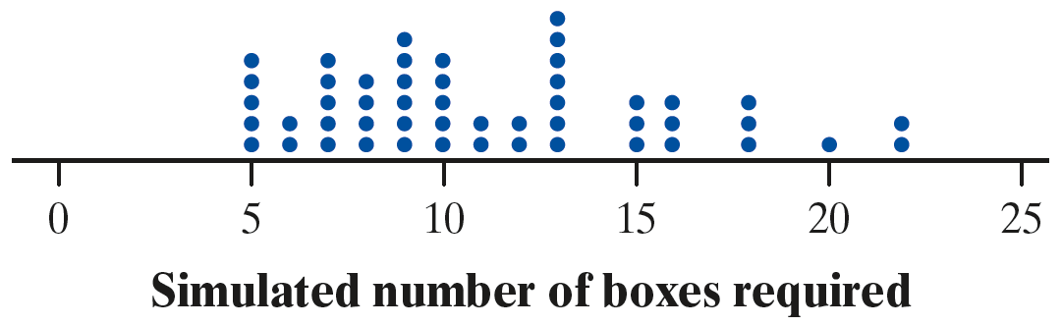
Simulation
The dotplot shows the number of cereal boxes it took to get all 5 drivers’ cards in 50 trials.
Explain what the dot at 20 represents.

Slide 22
Simulation
The dotplot shows the number of cereal boxes it took to get all 5 drivers’ cards in 50 trials.
Explain what the dot at 20 represents.
(b) One trial where it took 20 boxes to get all 5 drivers’ cards.

Slide 23
Simulation
The dotplot shows the number of cereal boxes it took to get all 5 drivers’ cards in 50 trials.
(b) Explain what the dot at 20 represents.
Use the results of the simulation to estimate the probability that it will take 23 or more boxes to get a
full set of cards. Does this outcome
provide convincing evidence that
the 5 cards are not equally likely?
(b) One trial where it took 20 boxes to get all 5 drivers’ cards.

Slide 24
Simulation
The dotplot shows the number of cereal boxes it took to get all 5 drivers’ cards in 50 trials.
(b) Explain what the dot at 20 represents.
Use the results of the simulation to estimate the probability that it will take 23 or more boxes to get a
full set of cards. Does this outcome
provide convincing evidence that
the 5 cards are not equally likely?
(b) One trial where it took 20 boxes to get all 5 drivers’ cards.
(c) Probability ≈ 0/50 = 0, so there’s about a 0% chance it would take 23 or more boxes to get a full set. Because it is so unlikely that it would take 23 or more boxes to get a full set, this result provides convincing evidence that the 5 NASCAR drivers’ cards are not equally likely to appear in each box of cereal.

Slide 25
Section Summary
INTERPRET probability as a long-run relative frequency.
USE simulation to model chance behavior.

Slide 26
Assignment
5.1 p. 308-313 #2-22 EOE, 16, and 23-30 all
(2, 6, 10, 14, 16, 18, 22, 23-30)
AND 5.1 Handout (front and back)
If you are stuck on any of these, look at the odd before or after and the answer in the back of your book. If you are still not sure text a friend or me for help (before 8pm).
Tomorrow we will check homework and review for 5.1 Quiz.

