Slide 1
Pull 2 samples of 5 pennies and record both averages (2 dots).
We are going to discuss 6.1 today.

Slide 2


Chapter 6
Random Variables
Section 6.1
Discrete and Continuous
Random Variables

Slide 3
Discrete and Continuous Random Variables
USE the probability distribution of a discrete random variable to CALCULATE the probability of an event.
MAKE a histogram to display the probability distribution of a discrete random variable and DESCRIBE its shape.
CALCULATE and INTERPRET the mean (expected value) of a discrete random variable.
CALCULATE and INTERPRET the standard deviation of a discrete random variable.
USE the probability distribution of a continuous random variable (uniform or Normal) to CALCULATE the probability of an event.

Slide 4
Discrete Random Variables
  A probability model describes the possible outcomes of a chance process and the likelihood that those outcomes will occur.

Slide 5
Discrete Random Variables
  A probability model describes the possible outcomes of a chance process and the likelihood that those outcomes will occur.
Consider tossing a fair coin 3 times.
Define the random variable X = the number of heads obtained

Slide 6
Discrete Random Variables
  A probability model describes the possible outcomes of a chance process and the likelihood that those outcomes will occur.
Consider tossing a fair coin 3 times.
Define the random variable X = the number of heads obtained
X = 0: TTT
X = 1: HTT THT TTH
X = 2: HHT HTH THH
X = 3: HHH
Value of X | 0 | 1 | 2 | 3
Probability | 1/8 | 3/8 | 3/8 | 1/8

Slide 7
Discrete Random Variables
  A probability model describes the possible outcomes of a chance process and the likelihood that those outcomes will occur.
Consider tossing a fair coin 3 times.
Define the random variable X = the number of heads obtained
X = 0: TTT
X = 1: HTT THT TTH
X = 2: HHT HTH THH
X = 3: HHH
Value of X | 0 | 1 | 2 | 3
Probability | 1/8 | 3/8 | 3/8 | 1/8
A random variable takes numerical values that describe the outcomes of a chance process.
The probability distribution of a random variable gives its possible values and their probabilities.

Slide 8
Discrete Random Variables
Probability Distribution for a Discrete Random Variable
The probability distribution of a discrete random variable X lists the values x_{i} and their probabilities p_{i}:
For the probability distribution to be valid, the probabilities p_{i} must satisfy two requirements:
Every probability p_{i} is a number between 0 and 1, inclusive.
The sum of the probabilities is 1: p₁ + p₂ + p₃ + . . . = 1.
Value | x₁ | x₂ | x₃ | …
Probability | p₁ | p₂ | p₃ | …

Slide 9
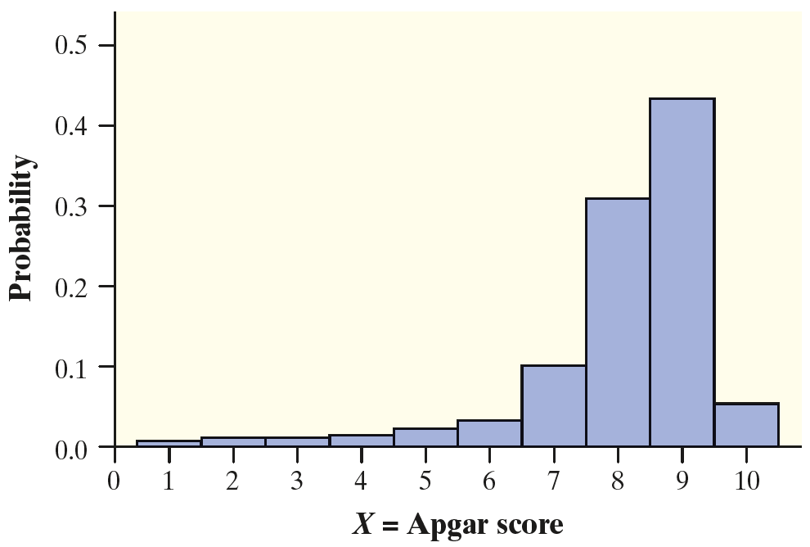
Analyzing Discrete Random Variables:
Describing Shape
When we analyzed distributions of quantitative data in Chapter 1, we made it a point to discuss their shape, center, and variability.

Slide 10
Analyzing Discrete Random Variables:
Describing Shape
When we analyzed distributions of quantitative data in Chapter 1, we made it a point to discuss their shape, center, and variability.
We’ll do the same with probability distributions of random variables.

Slide 11
Analyzing Discrete Random Variables:
Describing Shape
When we analyzed distributions of quantitative data in Chapter 1, we made it a point to discuss their shape, center, and variability.
We’ll do the same with probability distributions of random variables.
This distribution is skewed to the left
with a single peak at an Apgar score of 9.

Slide 12
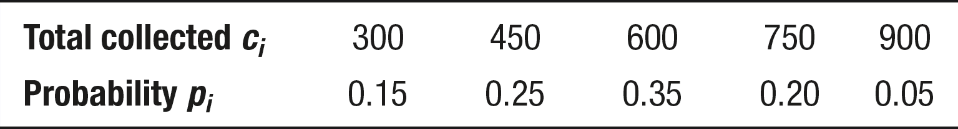
Analyzing Discrete Random Variables:
Describing Shape
Problem: Pete’s Jeep Tours offers a popular day trip in a tourist area.
There must be at least 2 passengers for the trip to run, and the vehicle
will hold up to 6 passengers. Pete charges $150 per passenger. Let C =
the total amount of money that Pete collects on a randomly selected
trip. The probability
distribution of C is
given in the table.
Make a histogram of the probability distribution. Describe its shape.
Judy M. Starnes

Slide 13
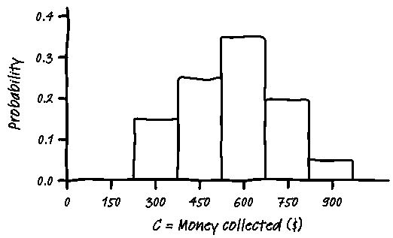
Analyzing Discrete Random Variables:
Describing Shape
Problem: Pete’s Jeep Tours offers a popular day trip in a tourist area.
There must be at least 2 passengers for the trip to run, and the vehicle
will hold up to 6 passengers. Pete charges $150 per passenger. Let C =
the total amount of money that Pete collects on a randomly selected
trip. The probability
distribution of C is
given in the table.
Make a histogram of the probability distribution. Describe its shape.
Judy M. Starnes

Slide 14
Analyzing Discrete Random Variables:
Describing Shape
Problem: Pete’s Jeep Tours offers a popular day trip in a tourist area.
There must be at least 2 passengers for the trip to run, and the vehicle
will hold up to 6 passengers. Pete charges $150 per passenger. Let C =
the total amount of money that Pete collects on a randomly selected
trip. The probability
distribution of C is
given in the table.
Make a histogram of the probability distribution. Describe its shape.
The graph is
approximately
symmetric
and has a
single peak
at $600.
Judy M. Starnes

Slide 15
Measuring Center: The Mean (Expected Value) of a Discrete Random Variable
The mean (expected value) of any discrete random variable is an average of the possible outcomes, but a weighted average in which each outcome is weighted by its probability.

Slide 16
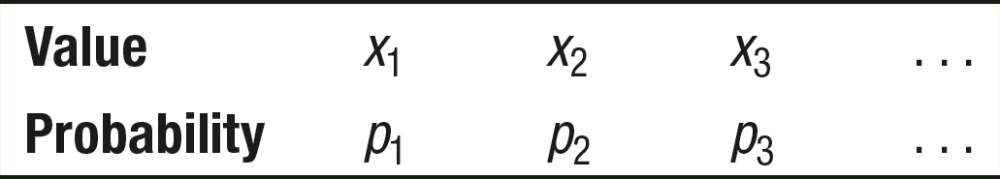
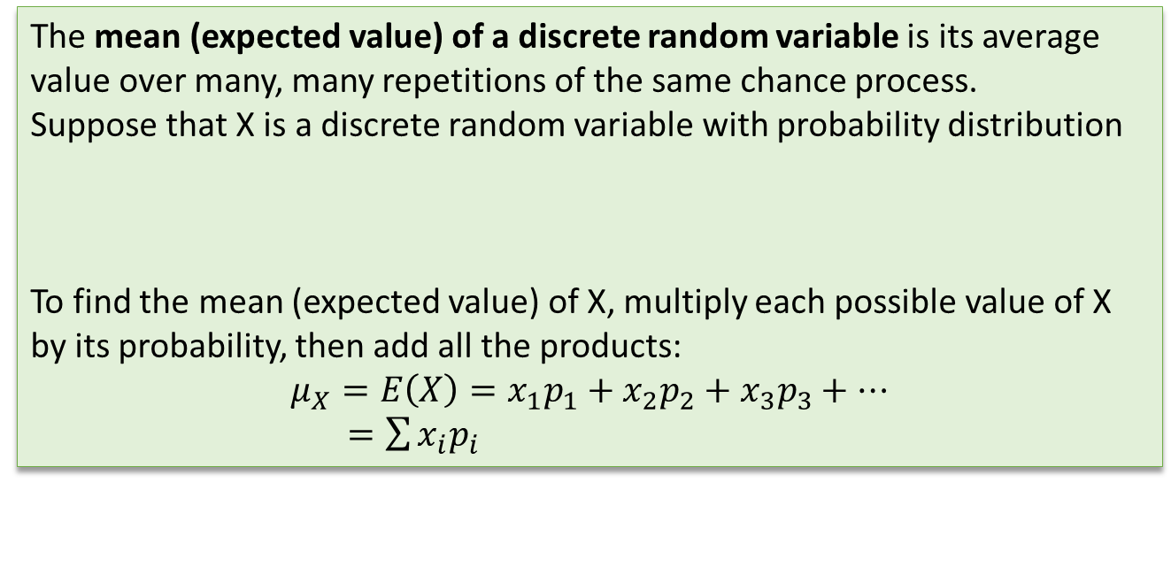
Measuring Center: The Mean (Expected Value) of a Discrete Random Variable
The mean (expected value) of any discrete random variable is an average of the possible outcomes, but a weighted average in which each outcome is weighted by its probability.
The mean (expected value) of a discrete random variable is its average value over many, many repetitions of the same chance process.
Suppose that X is a discrete random variable with probability distribution
To find the mean (expected value) of X, multiply each possible value of X by its probability, then add all the products:
$$μ_{X}=E\left(X\right)=x_{1}p_{1}+x_{2}p_{2}+x_{3}p_{3}+⋯$$
$=\sum{x_{i}p_{i}}$

Slide 17
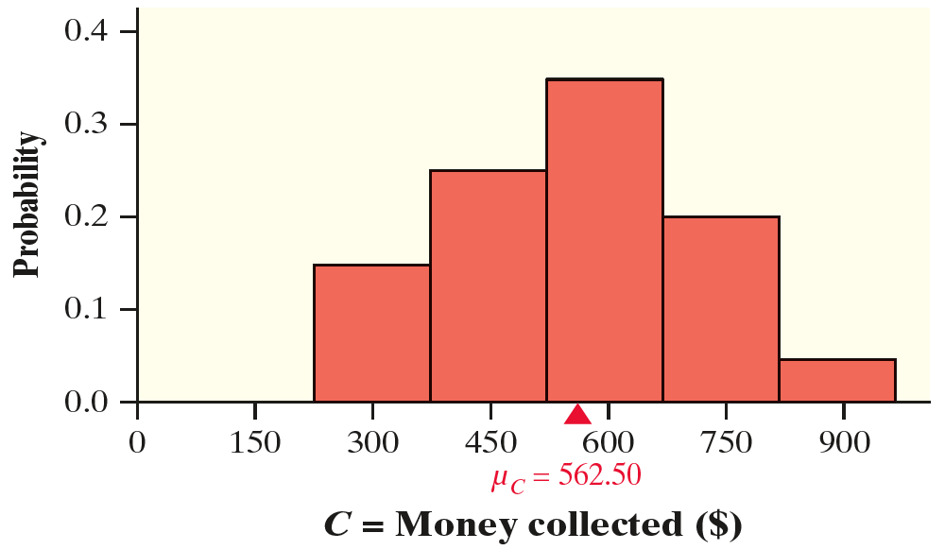
Measuring Center: The Mean (Expected Value) of a Discrete Random Variable
For Pete’s distribution,
µ_{C} = $562.50

Slide 18
Measuring Center: The Mean (Expected Value) of a Discrete Random Variable
For Pete’s distribution,
µ_{C} = $562.50
Recall that the mean is the balance point of a distribution.

Slide 19
Measuring Center: The Mean (Expected Value) of a Discrete Random Variable
For Pete’s distribution,
µ_{C} = $562.50
Recall that the mean is the balance point of a distribution.
How do we interpret this value?

Slide 20
Measuring Center: The Mean (Expected Value) of a Discrete Random Variable
For Pete’s distribution,
µ_{C} = $562.50
Recall that the mean is the balance point of a distribution.
How do we interpret this value?
If we randomly select many, many jeep tours, Pete will make about $562.50 per trip, on average.

Slide 21
Measuring Center: The Mean (Expected Value) of a Discrete Random Variable
Problem: Earlier, we defined the random variable X to be the Apgar score of a randomly selected newborn baby. The table gives the probability distribution of X once again.
Calculate and interpret the expected value of X.
susaro/iStock/Getty Images

Slide 22
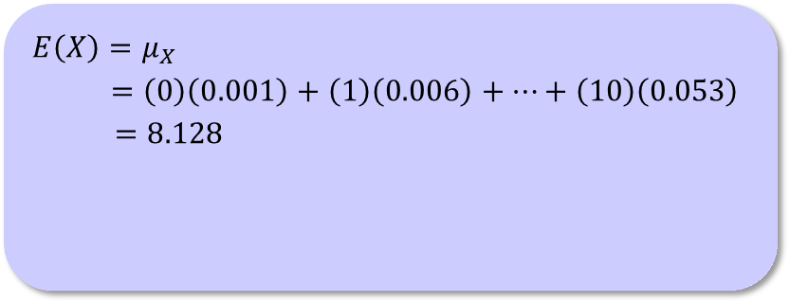
Measuring Center: The Mean (Expected Value) of a Discrete Random Variable
Problem: Earlier, we defined the random variable X to be the Apgar score of a randomly selected newborn baby. The table gives the probability distribution of X once again.
Calculate and interpret the expected value of X.
$$E\left(X\right)=μ_{X}$$
$=\left(0\right)\left(0.001\right)+\left(1\right)\left(0.006\right)+⋯+\left(10\right)\left(0.053\right)$
$=8.128$
susaro/iStock/Getty Images

Slide 23
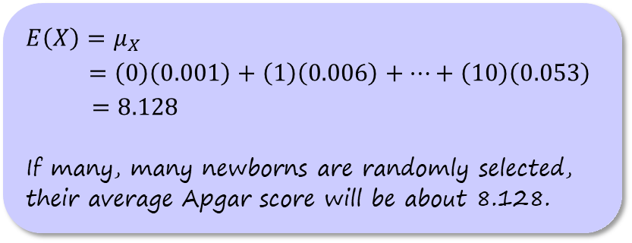
Measuring Center: The Mean (Expected Value) of a Discrete Random Variable
Problem: Earlier, we defined the random variable X to be the Apgar score of a randomly selected newborn baby. The table gives the probability distribution of X once again.
Calculate and interpret the expected value of X.
$$E\left(X\right)=μ_{X}$$
$=\left(0\right)\left(0.001\right)+\left(1\right)\left(0.006\right)+⋯+\left(10\right)\left(0.053\right)$
$=8.128$
If many, many newborns are randomly selected, their average Apgar score will be about 8.128.
susaro/iStock/Getty Images

Slide 24
Measuring Variability: The Standard Deviation (and Variance) of a Discrete Random Variable
With the mean as our measure of center for a discrete random variable, it shouldn’t surprise you that we’ll use the standard deviation as our measure of variability.

Slide 25
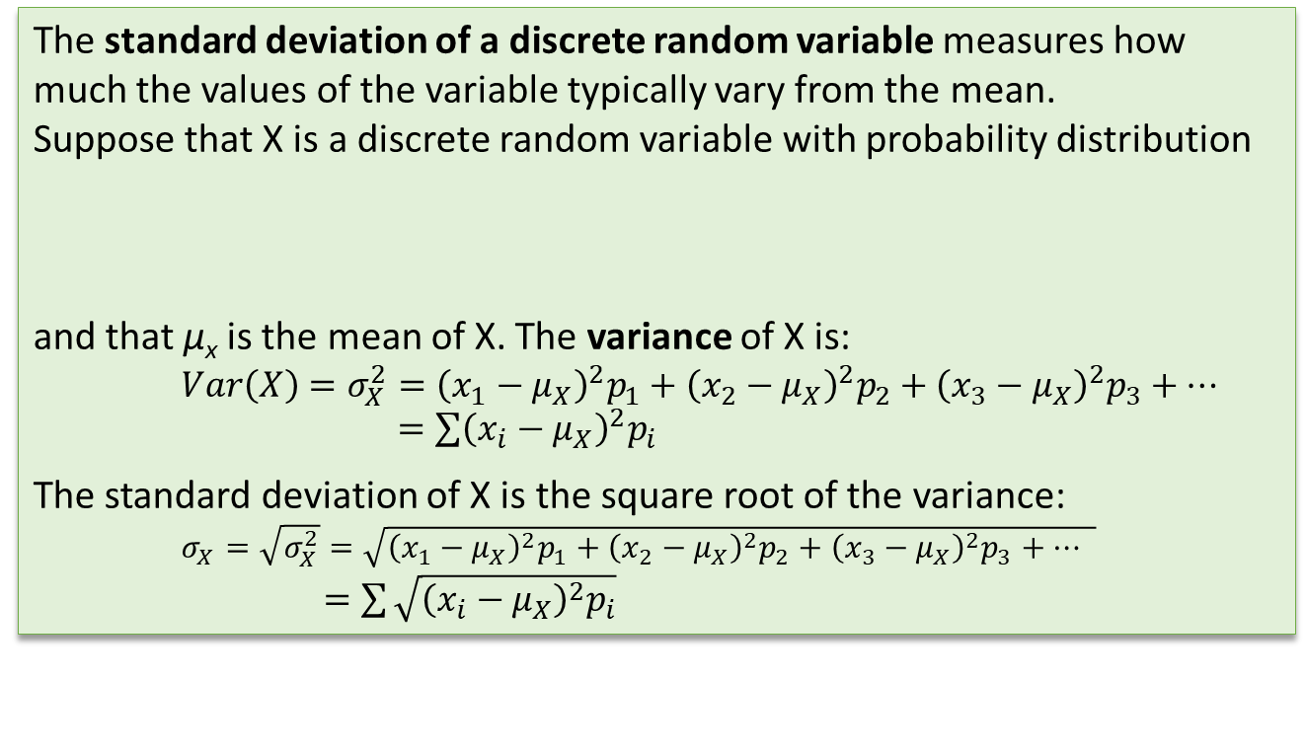
Measuring Variability: The Standard Deviation (and Variance) of a Discrete Random Variable
With the mean as our measure of center for a discrete random variable, it shouldn’t surprise you that we’ll use the standard deviation as our measure of variability.
The standard deviation of a discrete random variable measures how much the values of the variable typically vary from the mean.
Suppose that X is a discrete random variable with probability distribution
and that µ_{x} is the mean of X. The variance of X is:
$$Var\left(X\right)=σ_{X}^{2}={\left(x_{1}−μ_{X}\right)}^{2}p_{1}+{\left(x_{2}−μ_{X}\right)}^{2}p_{2}+{\left(x_{3}−μ_{X}\right)}^{2}p_{3}+⋯$$
$=\sum{{\left(x_{i}−μ_{X}\right)}^{2}p_{i}}$
The standard deviation of X is the square root of the variance:
$σ_{X}=\sqrt{σ_{X}^{2}}=\sqrt{{\left(x_{1}−μ_{X}\right)}^{2}p_{1}+{\left(x_{2}−μ_{X}\right)}^{2}p_{2}+{\left(x_{3}−μ_{X}\right)}^{2}p_{3}+⋯ }$
$=\sum{\sqrt{{\left(x_{i}−μ_{X}\right)}^{2}p_{i}}}$

Slide 26
Measuring Variability: The Standard Deviation (and Variance) of a Discrete Random Variable
Problem: Earlier, we defined the random variable X to be the Apgar score of a randomly selected newborn baby. The table gives the probability distribution of X once again. In the last example, we calculated the mean Apgar score of a randomly chosen newborn to be µ_{x} = 8.128.
Calculate and interpret the standard deviation of X.
susaro/iStock/Getty Images

Slide 27
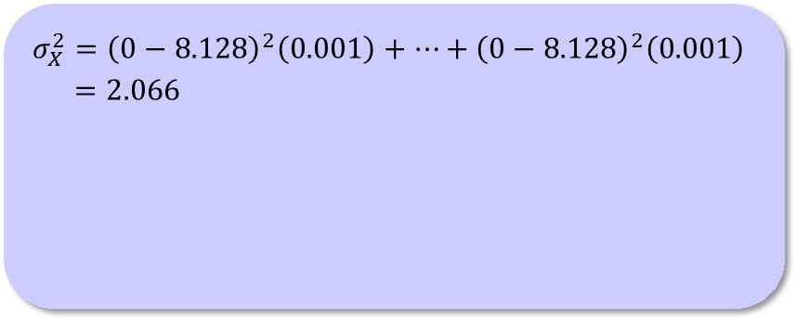
Measuring Variability: The Standard Deviation (and Variance) of a Discrete Random Variable
Problem: Earlier, we defined the random variable X to be the Apgar score of a randomly selected newborn baby. The table gives the probability distribution of X once again. In the last example, we calculated the mean Apgar score of a randomly chosen newborn to be µ_{x} = 8.128.
Calculate and interpret the standard deviation of X.
$$σ_{X}^{2}={\left(0−8.128\right)}^{2}\left(0.001\right)+⋯+{\left(0−8.128\right)}^{2}\left(0.001\right)$$
$=2.066$
susaro/iStock/Getty Images

Slide 28
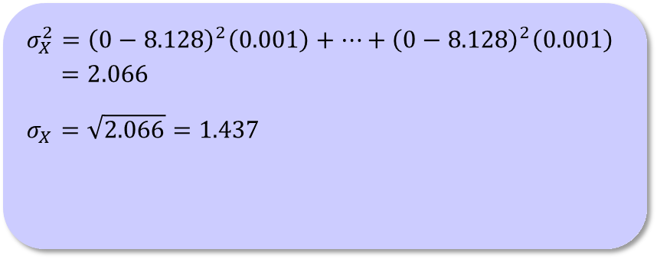
Measuring Variability: The Standard Deviation (and Variance) of a Discrete Random Variable
Problem: Earlier, we defined the random variable X to be the Apgar score of a randomly selected newborn baby. The table gives the probability distribution of X once again. In the last example, we calculated the mean Apgar score of a randomly chosen newborn to be µ_{x} = 8.128.
Calculate and interpret the standard deviation of X.
$$σ_{X}^{2}={\left(0−8.128\right)}^{2}\left(0.001\right)+⋯+{\left(0−8.128\right)}^{2}\left(0.001\right)$$
$=2.066$
$$σ_{X}=\sqrt{2.066}=1.437$$
susaro/iStock/Getty Images

Slide 29
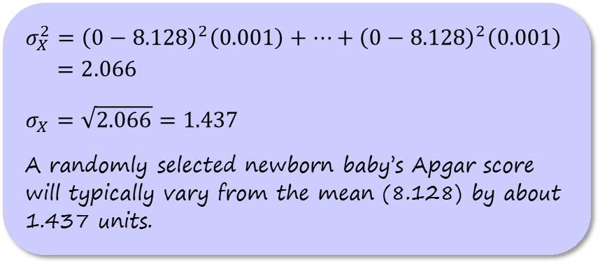
Measuring Variability: The Standard Deviation (and Variance) of a Discrete Random Variable
Problem: Earlier, we defined the random variable X to be the Apgar score of a randomly selected newborn baby. The table gives the probability distribution of X once again. In the last example, we calculated the mean Apgar score of a randomly chosen newborn to be µ_{x} = 8.128.
Calculate and interpret the standard deviation of X.
$$σ_{X}^{2}={\left(0−8.128\right)}^{2}\left(0.001\right)+⋯+{\left(0−8.128\right)}^{2}\left(0.001\right)$$
$=2.066$
$$σ_{X}=\sqrt{2.066}=1.437$$
A randomly selected newborn baby’s Apgar score will typically vary from the mean (8.128) by about 1.437 units.
susaro/iStock/Getty Images

Slide 30
Continuous Random Variables
A continuous random variable can take any value in an interval on the number line.

Slide 31
Continuous Random Variables
A continuous random variable can take any value in an interval on the number line.
How to Find Probabilities for a Continuous Random Variable
The probability of any event involving a continuous random variable is the
area under the density curve and directly above the values on the horizontal axis that make up the event.

Slide 32
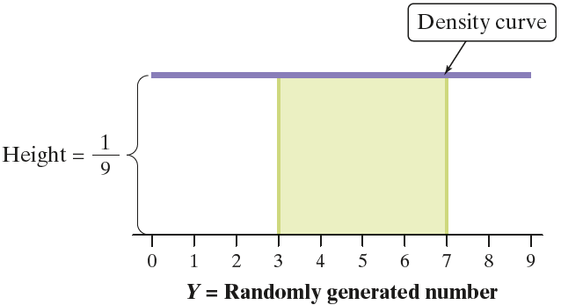
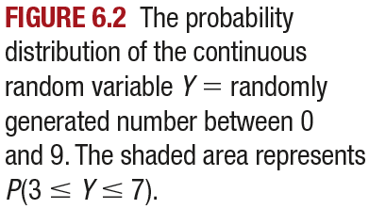
Continuous Random Variables
A continuous random variable can take any value in an interval on the number line.
How to Find Probabilities for a Continuous Random Variable
The probability of any event involving a continuous random variable is the
area under the density curve and directly above the values on the horizontal axis that make up the event.

Slide 33
Continuous Random Variables
Problem: Selena works at a bookstore in the Denver International Airport. She takes the airport train from the main terminal to get to work each day. The airport just opened a new walkway that would allow Selena to get from the main terminal to the bookstore in 4 minutes. She wonders if it will be faster to walk or take the train to work. Let Y = Selena’s journey time to work (in minutes) by train on a randomly selected day. The probability distribution of Y can be modeled by a uniform density curve on the interval from 2 to 5 minutes. Find the probability that it will be quicker for Selena to take the train than to walk that day.

Slide 34
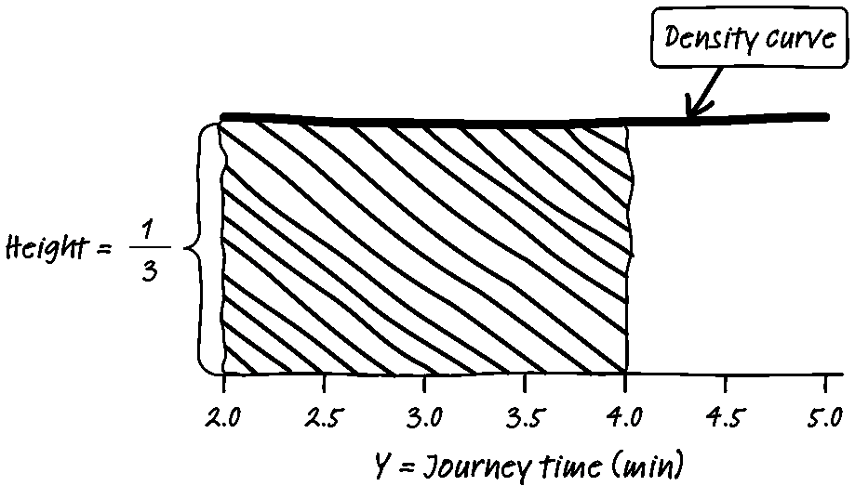
Continuous Random Variables
Problem: Selena works at a bookstore in the Denver International Airport. She takes the airport train from the main terminal to get to work each day. The airport just opened a new walkway that would allow Selena to get from the main terminal to the bookstore in 4 minutes. She wonders if it will be faster to walk or take the train to work. Let Y = Selena’s journey time to work (in minutes) by train on a randomly selected day. The probability distribution of Y can be modeled by a uniform density curve on the interval from 2 to 5 minutes. Find the probability that it will be quicker for Selena to take the train than to walk that day.

Slide 35
Continuous Random Variables
Problem: Selena works at a bookstore in the Denver International Airport. She takes the airport train from the main terminal to get to work each day. The airport just opened a new walkway that would allow Selena to get from the main terminal to the bookstore in 4 minutes. She wonders if it will be faster to walk or take the train to work. Let Y = Selena’s journey time to work (in minutes) by train on a randomly selected day. The probability distribution of Y can be modeled by a uniform density curve on the interval from 2 to 5 minutes. Find the probability that it will be quicker for Selena to take the train than to walk that day.
Shaded area = base × height
= 2 × 1/3
= 2/3

Slide 36
Continuous Random Variables
Problem: Selena works at a bookstore in the Denver International Airport. She takes the airport train from the main terminal to get to work each day. The airport just opened a new walkway that would allow Selena to get from the main terminal to the bookstore in 4 minutes. She wonders if it will be faster to walk or take the train to work. Let Y = Selena’s journey time to work (in minutes) by train on a randomly selected day. The probability distribution of Y can be modeled by a uniform density curve on the interval from 2 to 5 minutes. Find the probability that it will be quicker for Selena to take the train than to walk that day.
Shaded area = base × height
= 2 × 1/3
= 2/3
P(Y < 4) = 2/3 = 0.667

Slide 37
Continuous Random Variables
Problem: Selena works at a bookstore in the Denver International Airport. She takes the airport train from the main terminal to get to work each day. The airport just opened a new walkway that would allow Selena to get from the main terminal to the bookstore in 4 minutes. She wonders if it will be faster to walk or take the train to work. Let Y = Selena’s journey time to work (in minutes) by train on a randomly selected day. The probability distribution of Y can be modeled by a uniform density curve on the interval from 2 to 5 minutes. Find the probability that it will be quicker for Selena to take the train than to walk that day.
Shaded area = base × height
= 2 × 1/3
= 2/3
P(Y < 4) = 2/3 = 0.667
There is a 66.7% chance that it
will be quicker for Selena to take
the train to work on a randomly
selected day.

Slide 38
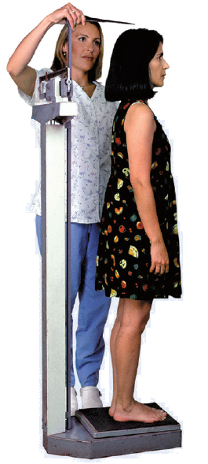
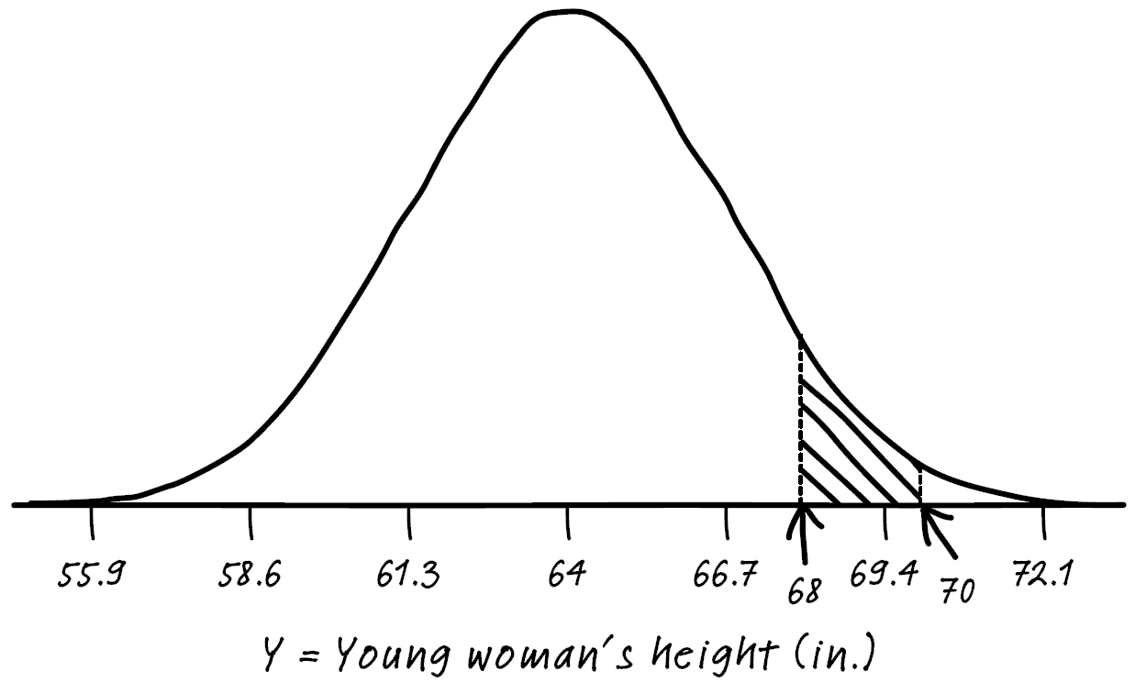
Continuous Random Variables
Problem: The heights of young women can be modeled by a Normal distribution
with mean µ = 64 inches and standard deviation σ = 2.7 inches. Suppose we choose a young woman at random and let Y = her height (in inches).
Find P(68 ≤ Y ≤ 70). Interpret this value.

Slide 39

Continuous Random Variables
Problem: The heights of young women can be modeled by a Normal distribution
with mean µ = 64 inches and standard deviation σ = 2.7 inches. Suppose we choose a young woman at random and let Y = her height (in inches).
Find P(68 ≤ Y ≤ 70). Interpret this value.
$z=\frac{68−64}{2.7}=1.48$
$z=\frac{70−64}{2.7}=2.22$

Slide 40

Continuous Random Variables
Problem: The heights of young women can be modeled by a Normal distribution
with mean µ = 64 inches and standard deviation σ = 2.7 inches. Suppose we choose a young woman at random and let Y = her height (in inches).
Find P(68 ≤ Y ≤ 70). Interpret this value.
$z=\frac{68−64}{2.7}=1.48$
$z=\frac{70−64}{2.7}=2.22$
  Using Table A:
  0.9868 – 0.9306
  = 0.0562

Slide 41

Continuous Random Variables
Problem: The heights of young women can be modeled by a Normal distribution
with mean µ = 64 inches and standard deviation σ = 2.7 inches. Suppose we choose a young woman at random and let Y = her height (in inches).
Find P(68 ≤ Y ≤ 70). Interpret this value.
$z=\frac{68−64}{2.7}=1.48$
$z=\frac{70−64}{2.7}=2.22$
  Using Table A:
  0.9868 – 0.9306
  = 0.0562
  Using technology:
  normalcdf(lower:1.48, upper:2.22, mean:0, SD:1)
  = 0.0562

Slide 42
Continuous Random Variables
Problem: The heights of young women can be modeled by a Normal distribution
with mean µ = 64 inches and standard deviation σ = 2.7 inches. Suppose we choose a young woman at random and let Y = her height (in inches).
Find P(68 ≤ Y ≤ 70). Interpret this value.
normalcdf(lower:68, upper:70, mean:64, SD:2.7)
= 0.0561

Slide 43
Continuous Random Variables
Problem: The heights of young women can be modeled by a Normal distribution
with mean µ = 64 inches and standard deviation σ = 2.7 inches. Suppose we choose a young woman at random and let Y = her height (in inches).
Find P(68 ≤ Y ≤ 70). Interpret this value.
The probability that a randomly selected young woman has a height between 68 and 70 inches is about 0.056.

Slide 44
Section Summary
USE the probability distribution of a discrete random variable to CALCULATE the probability of an event.
MAKE a histogram to display the probability distribution of a discrete random variable and DESCRIBE its shape.
CALCULATE and INTERPRET the mean (expected value) of a discrete random variable.
CALCULATE and INTERPRET the standard deviation of a discrete random variable.
USE the probability distribution of a continuous random variable (uniform or Normal) to CALCULATE the probability of an event.

Slide 45
Assignment
6.1 p. 375-380 #4, 6, 8, 14, 18, 24, 28, 31-34
AND handout
If you are stuck on any of these, look at the odd before or after and the answer in the back of your book. If you are still not sure text a friend or me for help (before 8pm).
Tomorrow we will check homework and review for 6.1 Quiz.
Keep working on Taste Test, due Tues. AND Alber.io due Sun.

